Slide 1
Data Analytics
ANZ transaction data analysis

Slide 2
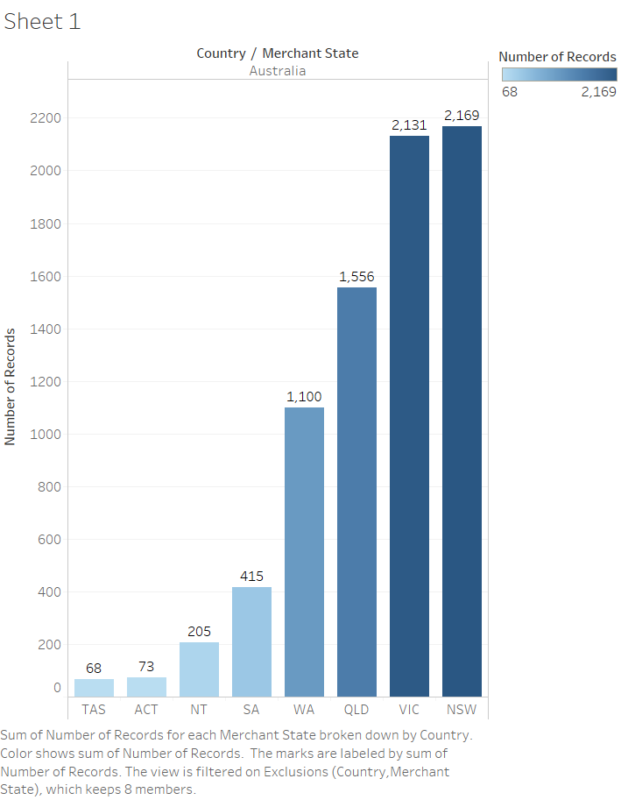
From the following graph we can say thay most of the data is from following states in Austrelia
NSW
VIC
QLD
WA

Slide 3
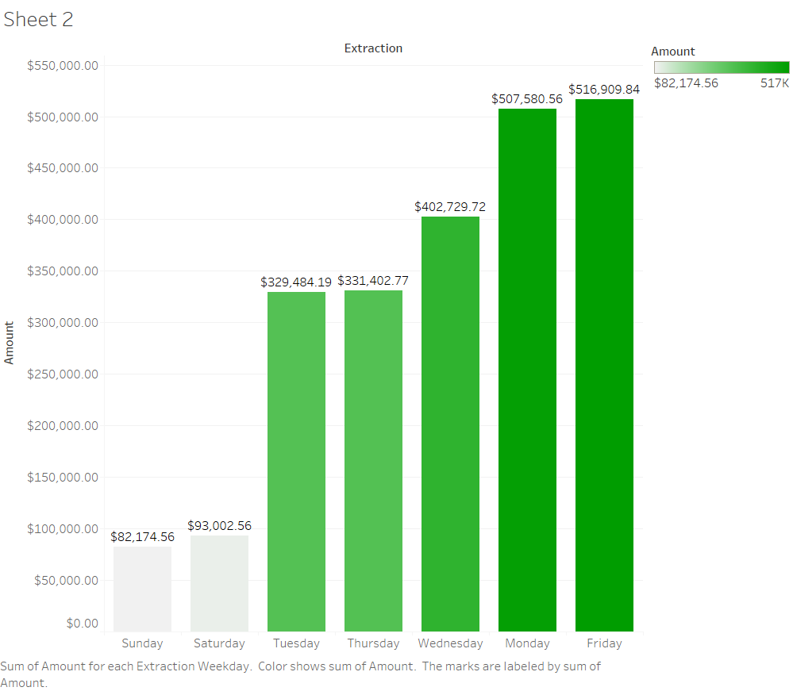
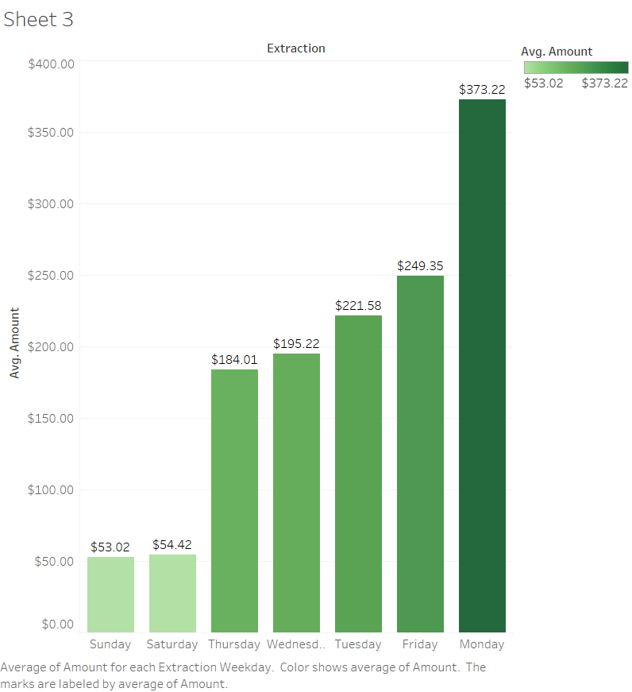
So from the analysis we found that on maximum total transactions are found on Mondays , Wednesday and Fridays . But if we look at the average Mondays have more average transaction amount
Total
Average

Slide 4
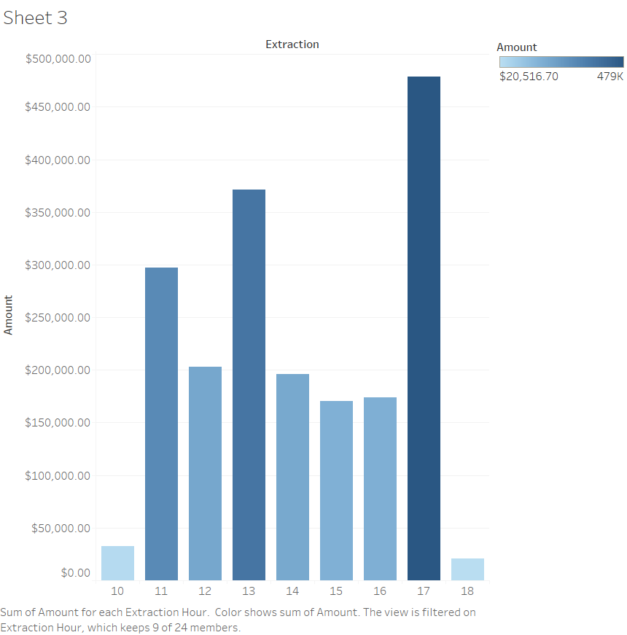
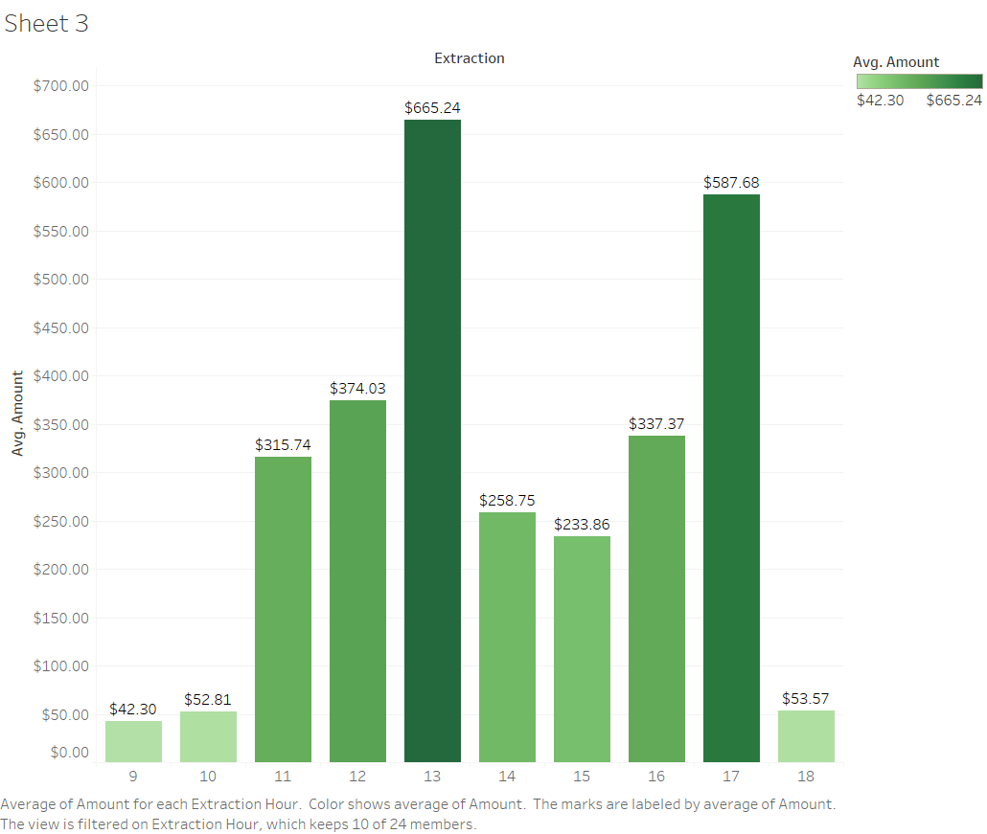
So from the analysis we found that on maximum total transactions are found in a day are in between 11am to 6pm and most at 5 pm . But if we look at the average at 1pm and 5pm have more average transaction amount .
Total
Average

Slide 5
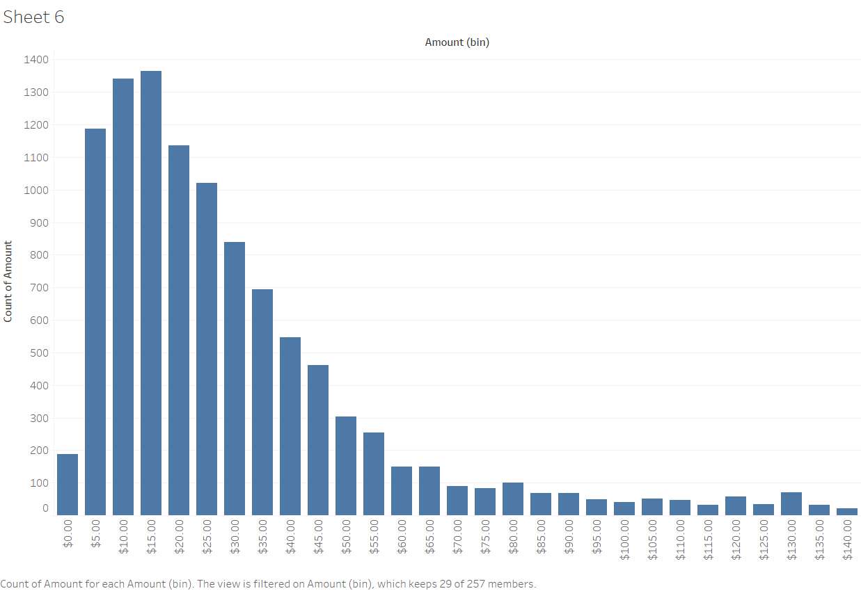
From above distribution of transaction amount we can say that maximum transation amount is between $5-$40 . And also we have some huge transaction amounts we can say outliers in between $5k-$6k .

